Slide 1
VA Fusion
Arjun Comar
Mary Roth

Slide 2
Features
Piano Mode – Snap-to Recording – Forced Rhythm – Free Recording – Instrument Selection and Combination – Free Play
Staff Mode – Simple gestures, character recognition – Quick Adjustments – Overall view – Play snippets or the whole piece – Copy/Paste!

Slide 3
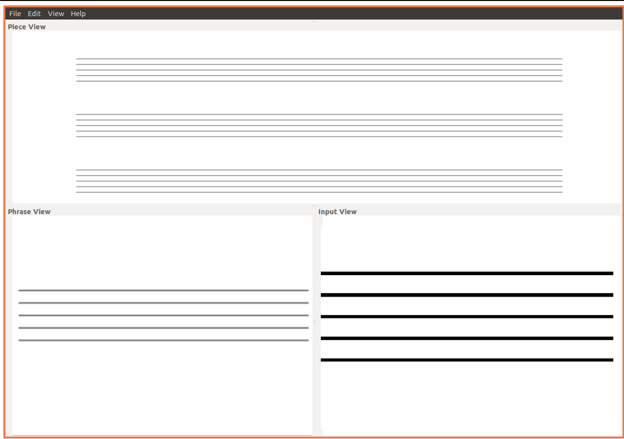
Staff Mode Mockup

